Slide 1
Digital Portfolio
STUDENT NAME:L.Prabavathy
REGISTER NO AND NMID: 6C3016863AC7033B72A403BE7BE2B69A
DEPARTMENT: Computer Application (BCA)
COLLEGE: Apollo Arts and Science college Chennai/MADRAS UNIVERSITY

Slide 2
PROJECT TITLE
PERSONAL PORTFOLIO WEBSITE USING FRONT-END DEVELOPMENT

Slide 3


AGENDA
Problem Statement
Project Overview
End Users
Tools and Technologies
Portfolio design and Layout
Features and Functionality
Results and Screenshots
Conclusion
Github Link
3/21/2024 Annual Review

Slide 4

PROBLEM STATEMENT
1. Need a personal online presence to showcase skills and achievements. 2. Centralize education, goals, and contact details in one place. 3. Highlight both academic and creative talents effectively. 4. Present information in a modern, user-friendly design. 5. Provide easy access for recruiters and collaborators.

Slide 5

PROJECT OVERVIEW
This project is a personal portfolio website designed to showcase my education, skills, goals, and interests in a simple and professional way. It serves as a digital profile where visitors can learn about me, explore my talents, and easily get in touch. The site highlights both academic and creative strengths with a clean, user-friendly design, making it a useful platform for personal branding and future career

Slide 6

WHO ARE THE END USERS?
1. Recruiters/Employers – to learn about qualifications and skills. 2. Teachers/Mentors – to track academic progress and personal growth. 3. Friends/Peers – to know interests, talents, and projects. 4. Collaborators – to connect for creative or academic projects. 5. General Audience – anyone interested in knowing more about me.

Slide 7

TOOLS AND TECHNIQUES
1. HTML5 – for structuring the webpage content. 2. CSS3 – for styling, layout, and visual design. 3. Google Fonts – for modern and clean typography. 4. Responsive Design – ensures the site works on different devices. 5. Animations (CSS keyframes) – adds interactivity and smooth effects.

Slide 8
POTFOLIO DESIGN AND LAYOUT
1. Fixed Navigation Bar – for quick access to sections. 2. Header Section – profile photo, name, and introduction. 3. About Section – education, goals, and skills overview. 4. Projects Section – placeholder to showcase future work. 5. Contact Section – email and phone details for easy reach. 6. Footer – simple copyright note.
8

Slide 9
FEATURES AND FUNCTIONALITY
1. Responsive Layout – adapts to different screen sizes. 2. Navigation Menu – smooth access to all sections. 3. Profile Display – photo, name, and introduction at the top. 4. About Section – details about education, goals, and skills. 5. Projects Section – placeholder for showcasing future work. 6. Contact Section – email and phone for communication. 7. CSS Animations – floating shapes and bounce effects for visual appeal.

Slide 10
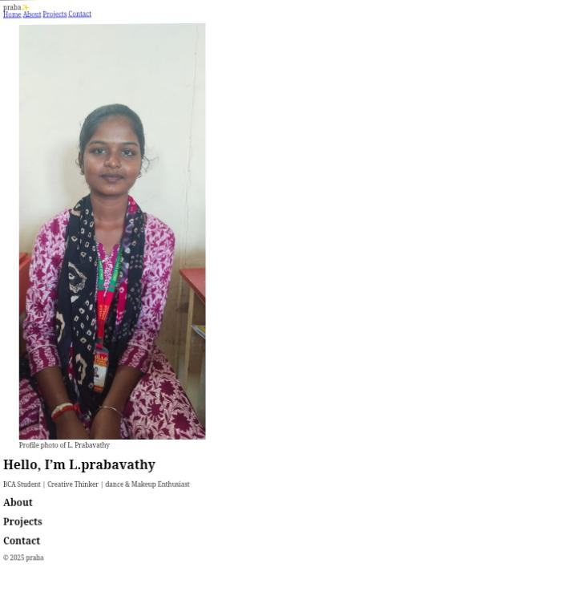
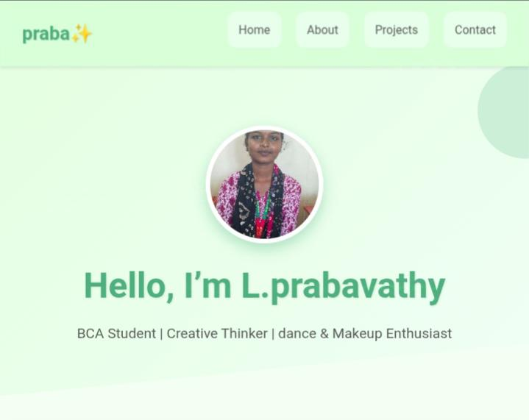

RESULTS AND SCREENSHOTS
Before adding CSS
After adding CSS
3/21/2024 Annual Review
10

Slide 11
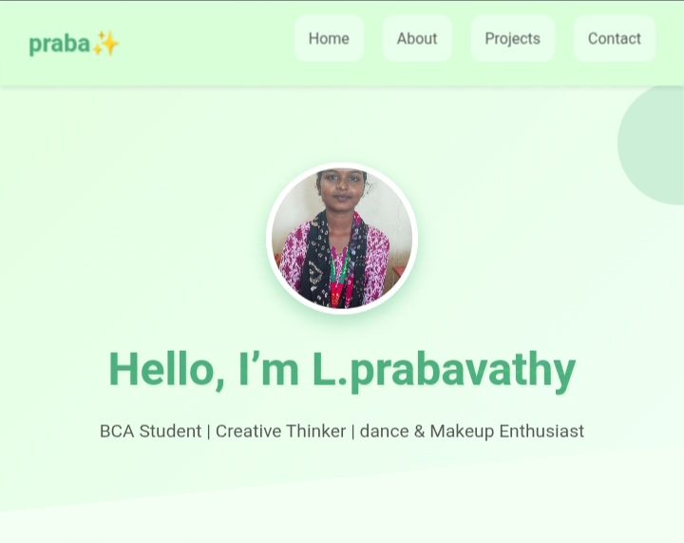
HOME SECTION:

Slide 12
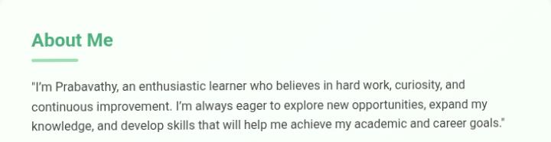
ABOUT ME :

Slide 13
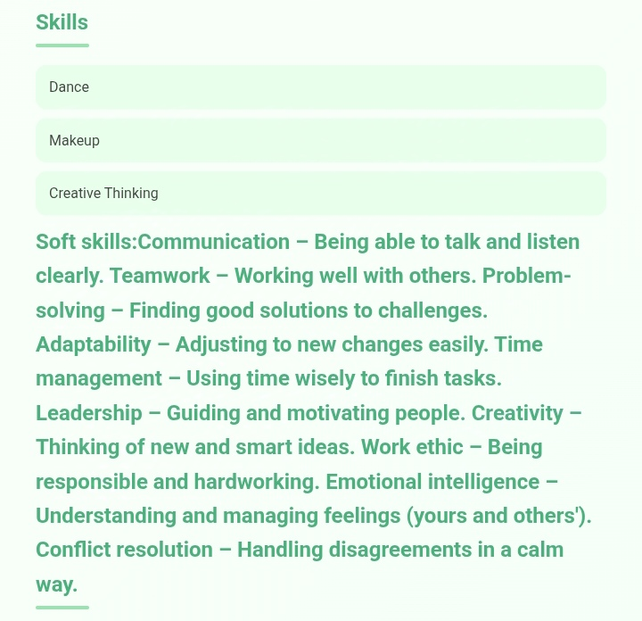
SKILLS :

Slide 14
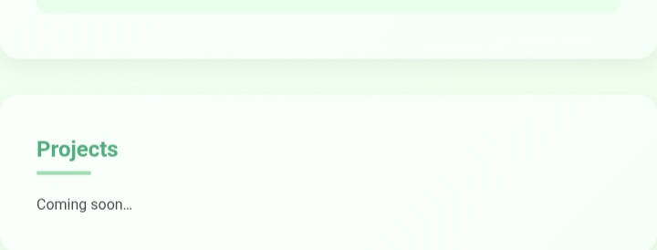
PROJECT:

Slide 15
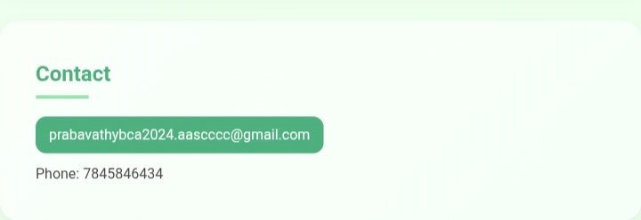
CONTACT:

Slide 16
CONCLUSION
This portfolio website successfully presents my personal, academic, and creative details in a simple and professional way. It provides a centralized platform to highlight my skills, education, and goals while maintaining a clean design and responsive layout. With sections for projects and contact, it not only serves as a digital resume but also as a foundation that can be expanded with future achievements and improvements
16

Slide 17
GITHUB LINK :
https://github.com/Prabavathy-lucas/Digital_Portfolio.git

